Slide 1

Project Phase 1 Academic Year (2021-22) Projective Exploration on Individual Stress Levels By ML
Team Members
1NH18CS712 - BHAVYA B
1NH18CS728 - KOTHA SREEJA
1NH18CS735 - BHARGAVI P
Guided By
Mr. Nagendra Prabhu S
Assistant Professor
Dept. of CSE, NHCE

Slide 2


AGENDA
Problem Statement
Literature Survey
Technology Details
Detailed Analysis of Literature Review
Conclusion
References

Slide 3
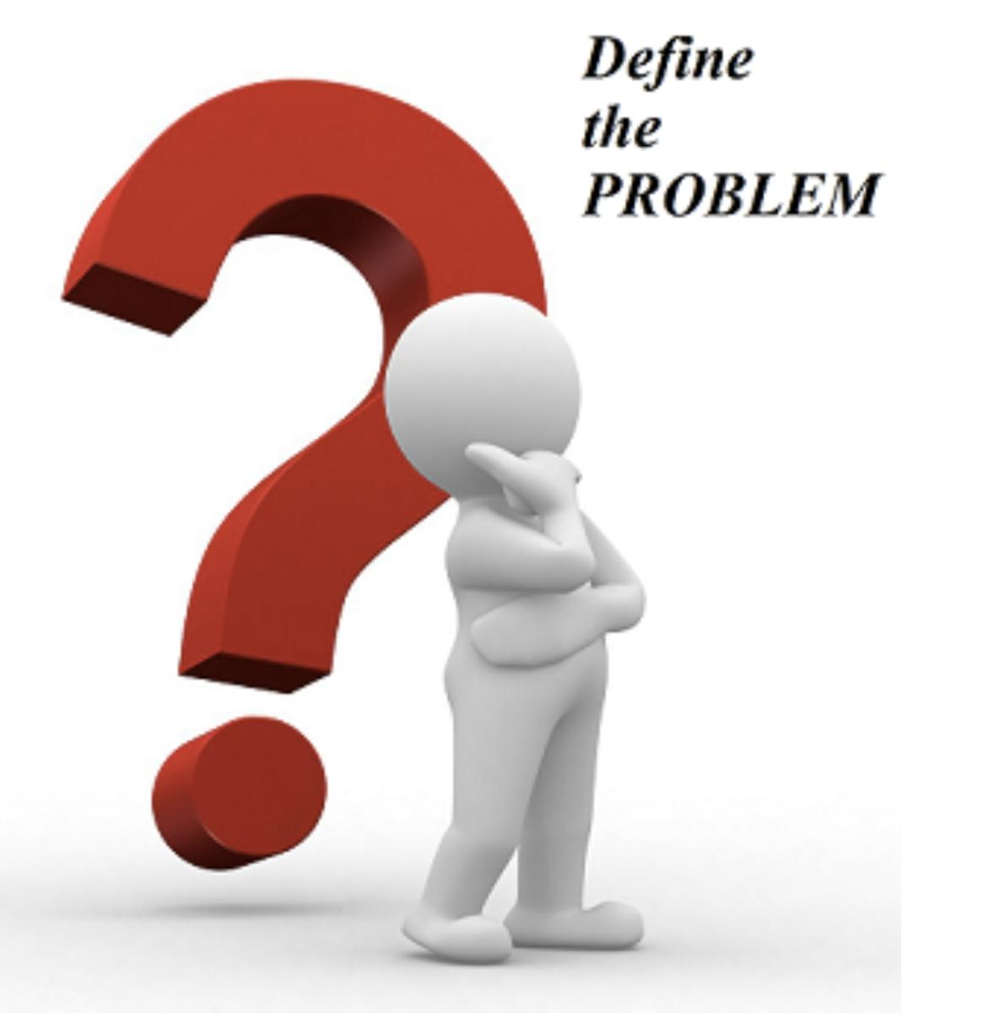
PRoBLEM STATEMENT
Stress Prediction in every individual based on their profile and behavior is a challenging task in the current sector. Current system is a manual process where it is difficult to identify the stress in every individuals. There is no automation for any stress prediction.
System uses machine learning algorithms or AI algorithms to find out the stress levels, these technologies are used for application development.

Slide 4


LITERATURE SURVEY
MACHINE LEARNING TECHNIQUES FOR STRESS PREDICTION IN WORKING EMPLOYEE
DETERMINATION AND CLASSIFICATION OF HUMAN STRESS INDEX USING NONPARAMETRIC ANALYSIS OF EEG SIGNALS.
CLUSTER-BASED ANALYSIS FOR PERSONALIZED STRESS EVALUATION USING PHYSIOLOGICAL SIGNALS.
IEEE JOURNAL OF BIOMEDICAL AND HEALTH INFORMATICS

Slide 5

EXISTING SYSTEM
In the existing system college students are facing so many mental health problems such as depression, pressure, stress, interpersonal sensitivity, fear, nervousness etc.
Though many industries and corporations provide mental health related schemes and try to ease the workplace atmosphere, the issue is far from control.

Slide 6

LIMITATIONS OF THE EXISTING SYSTEM
• No Automation for stress prediction
• Less user satisfaction
• Time consuming
• Less Reliable
• Less Efficient
• Manual Process

Slide 7
PROPOSED SYSTEM
With changing lifestyle and work culture, there is an increase in the risk of stress among the college students. Systems find factors that strongly determine the stress levels. Stress was identified based on gender, family history and availability of health benefits in the education sector.
By identifying the stress of students, system comes up with some approaches to reduce stress and create a much comfortable learning place for students.

Slide 8

OBJECTIVES:
Proposed system is a real time application.
The model classifies the students into Stressed and Stress Free.
Proposed system gives better decisions and also improvises the business.
Proposed system makes use of data science technique “classification rules” for predicting stress in college students.
Proposed system is meant for stress prediction. System build using “Visual Studio” as front-end technology and “SQL Server” as back-end technology.

Slide 9
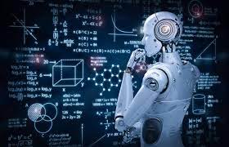
Technology details
MACHINE LEARNING
Machine Learning is a subset of Artificial Intelligence which trains the model without human Intervention.
It has been categorized into
Supervised learning
Unsupervised learning
Semi- Supervised learning .

Slide 10
Supervised Learning
Unsupervised learning
Semi-Supervised learning
Input data is called training data and has a known label or result such as spam or not spam, a stock price at a time.
Input data is not labelled and does not have a known result.
Input data is a mixture of-labelled and unlabeled examples

Slide 11
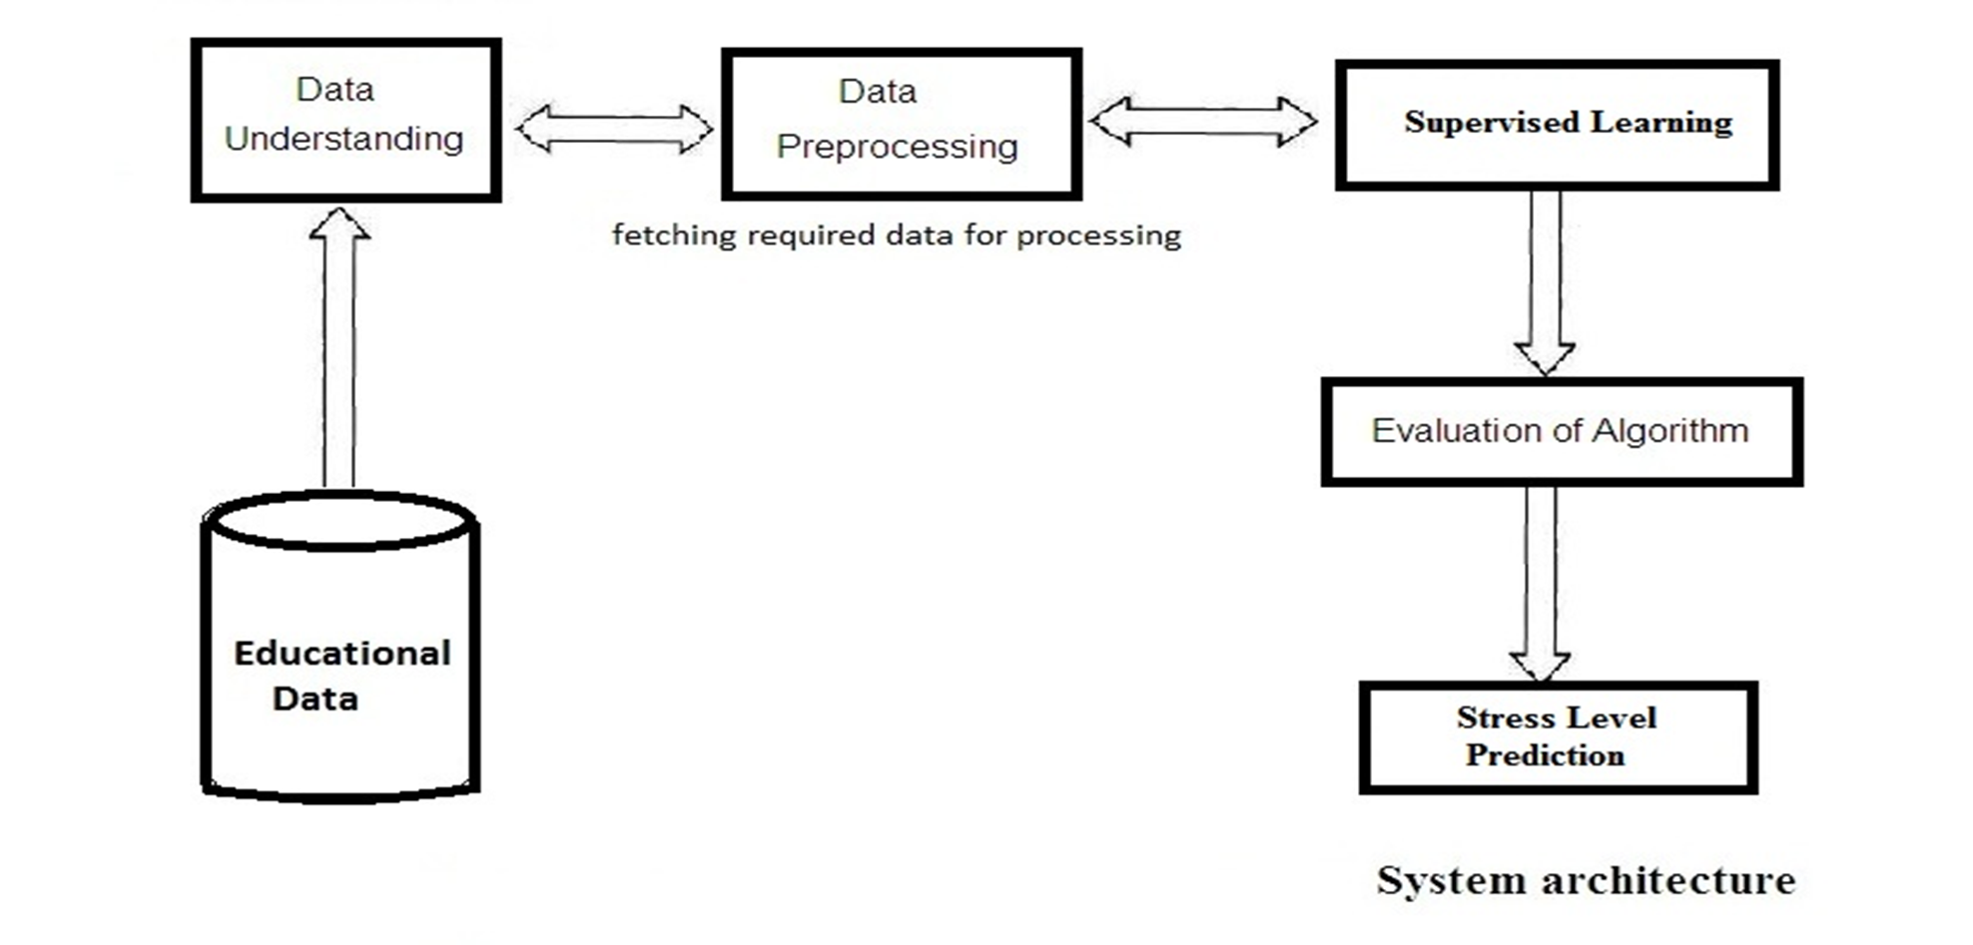
SYSTEM ARCHITECTURE

Slide 12
SOFTWARE REQUIREMENTS
Operating System | Windows
Design Tool | Visual Studio
Front End | ASP.NET 4.0
Language | C#
SQL Server | SQL Server
Data Access Technology | ADO.NET

Slide 13
System design
PRESENTATION LAYER
THE DATA LAYER
BUSINESS LAYER
The Project is based on three tier architecture and
consists of three layers. They are:

Slide 14
THE DATA LAYER
The data layer is a separate component (often setup as a separate single or group of projects in a .NET solution), whose sole purpose is to serve up the data from the database and return it to the caller.
BUSINESS LAYER
The business layer is vital in that it validates the input conditions before calling a method from the data layer.
PRESENTATION LAYER
The presentation layer is the most important layer simply because it’s the one that everyone sees and uses.

Slide 15
SYSTEM DETAILED DESIGN
ADMIN
STUDENT
GUEST
MODULES

Slide 16
OVERVIEW OF FUNCTIONALITIES OF MODULES

Slide 17
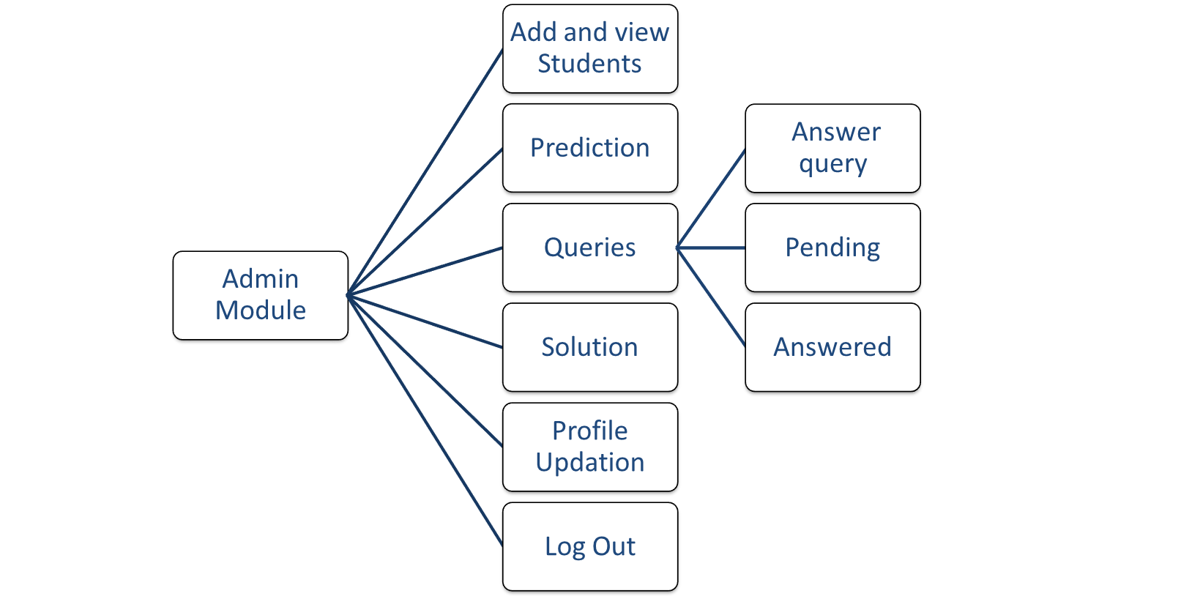
Admin module

Slide 18
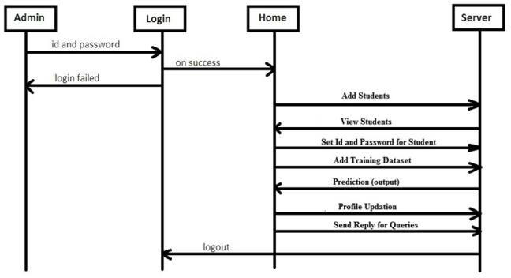
SEQUENCE DIAGRAM OF ADMIN MODULE

Slide 19
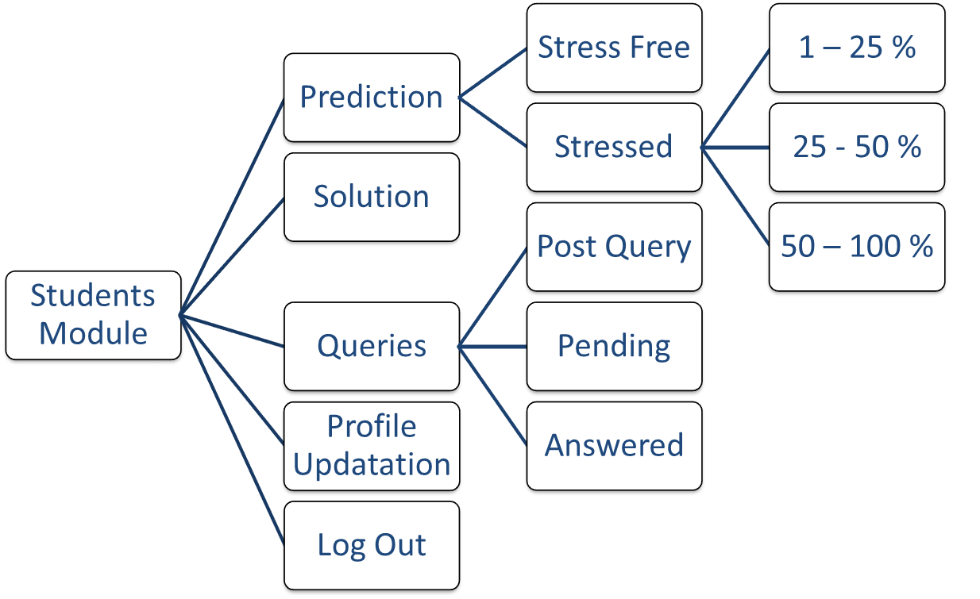
Student module

Slide 20
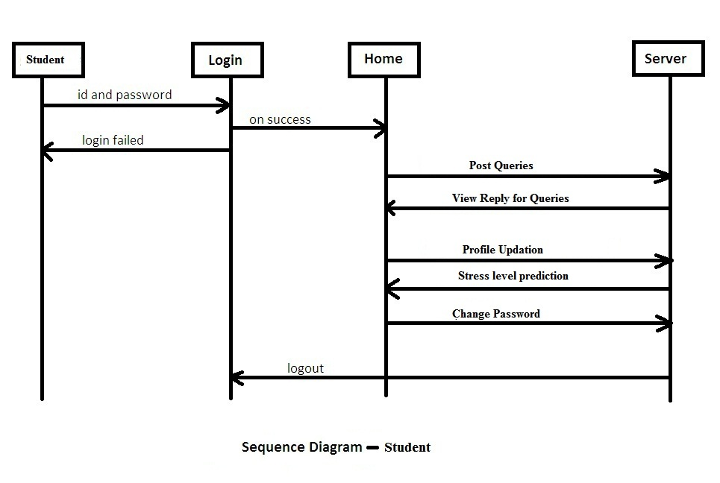
SEQUENCE DIAGRAM OF STUDENT MODULE

Slide 22
DETAILED ANALYSIS OF LITERATURE REVIEW
Sl. No | Title of the Journal | Authors | Publisher | Summary | Drawbacks
01 | Stress Prediction of students using machine learning. | Disha Sharma | Trans stellar | Technology used ML and Bayes net algo. | It shows the accuracy of 77% only
02 | iCare-Stress: Caring System for Stress. | Jarernsri Mitrpanont, Jaruwan Phandhu-fung | European journal of operational research, | Technology used Emotive Device which defines BCI | Basic health Questions are a set of only 30 questions only based on health.
03 | Automatic stress detection in working environments from smartphones. | Enrique gorcia | IEEE publications | Technology used naïve bayes,decision trees. | The overall accuracy was found to be 75%
04 | Prediction of mental health problems among children using machine learning techniques. | Dr.B. Poorna | International journal of advanced computer science | It is used by the weka tool. Formed with 60 instances | It generates multilayer perceptron.
05 | How COVID-19 affects mental health of college students and its countermeasures. | Yanliang zhang | International conference on public health and data science (ICPHDS). | It generates questionaries with four dimensions. | They can measure of mental health of a student in a covid pandemic through this project. Doesn’t display any accuracy.
06 | Personalized Stress Detection from Physiological Measurements. | Yuan shi,Minh hoai Nguyen | Radboud respository university | The concepts which was ECG, GSR, RIP, EMA, RBF kernels. | It precession over 50%.and now we use manually like a site.
07 | Detecting work stress in offices by combining unobtrusive sensors. | Saskia Koldijk, Mark A | IEEE publications | The Employees often record their experience of stress at work. | The final performance of Accuracy is 0.8416 which has been reached.

Slide 23
DETAILED ANALYSIS OF LITERATURE REVIEW
Sl. No | Title of the Journal | Authors | Publisher | Summary | Drawbacks
08 | Psychological Distress and Health-Related Quality of Life in Public Sector Personnel. | Christina S. Malfa | Environment research and public health | The health-related quality of life and psychological stress | It shows the accuracy of 67% only
09 | Detection of Stress Levels in Students using Social Media Feed. | Simhadri Naga Mounika | IEEE Publications | Deep learning concepts those are CNN, RNN, DNN algorithms. | The highest accuracy is 81.6 for RNN and for CNN is 69.8.
10 | Stress Detection with Machine Learning and Deep Learning using Multimodal Physiological Data | Pramod Bobade | IEEE Publications | amusement, baseline, and stress using Dl and ml. | Deep learning yielded accuracies up to 84.32 % and 95.21 %,
11 | Stress tree: A Metaphorical visualization for Biofeedback. | Bin Yu | DIS | used spss statistics 25.0 software for calculating accuracy. | It shows the accuracy of 77.09% only
12 | A Study of Automatic Stress Tracking Technology. | Shuhan wei | ICST | Self tracking practices. Like digital watches. | Digital prediction not shows accurate.
13 | Less sensing for Affective computing and stress management technology | David Sun | ICST | They are using computing devices as sensors. | Used a toy robot to detect stress which leads sometimes dangerous.
14 | A study on stress management among the employees in manufacturing industries. | John Canny | IJCRT | Anova and T-Test method used. | Stress predicted by eliminating each feature.
15 | Mental stress detection using wearable sensors | John paul | IEEE | Based on DL with wearable methods. | Through ECG signals it predicts.

Slide 24
system IMPLEMENTATION
Working of KNN algorithm is describes as:
A Euclidean distance formula is applied to calculate the shortest distance between the new record and all the old records.
The first K number of records are considered
All the shortest distances obtained are sorted in ascending order
A random value is assumed and assigned to a variable K
The highest count of the categorical variable is determined and assigned to the new record.
KNN ALGORITHM
Stress Prediction is determined with the help of a machine learning technique known as KNN-classification algorithm.

Slide 25
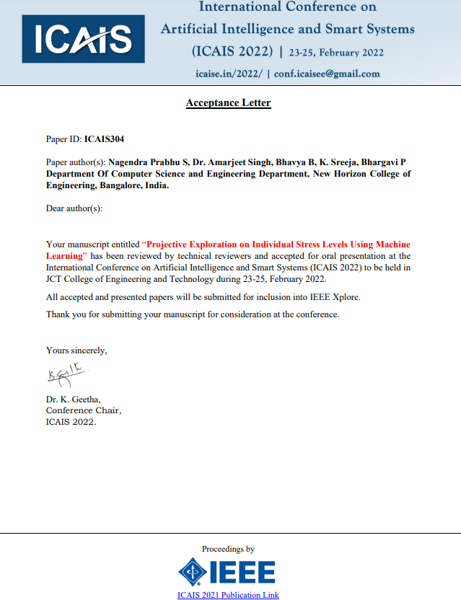
CONFERENCE PROCEEDINGS

Slide 26

conclusion
This project helps in predicting the stress levels due to various parameters considered through a survey and it also lists as to whether the students are stress free or stressful and the range of their stress levels.
The student can incorporate the solution and work towards maintaining his or her mental equilibrium.
So, this project helps an introvert may believe that going through an experience in great detail will eventually result in figuring out what went wrong according to those suggestions will be given and help them from stress.

Slide 27

REFERENCES
1. Disha sharma, nikitha Kapoor, Dr.sandeep. “Stress Prediction of students using machine learning”. Trans stellar, vol.10,issue 3, June 2020.
2. Jarernsri Mitrpanont, Jaruwan Phandhu-fung and Nantanut Klubdee.” iCare-Stress: Caring System for Stress”. European journal of operational research, 2017.
3. Enrique gorcia, venet osmani and Oscar mayora. “Automatic stress detection in working environments from smartphones”, 14 oct 2015.
4. MS. Sumathi M. R and Dr.B. Poorna. “Prediction of mental health problems among children using machine learning techniques”. International journal of advanced computer science, vol7, nov 1,2016.
5. Xiyu Liu and Yanliang zhang.” How COVID-19 affects mental health of college students and its countermeasures”. International conference on public health and data science (ICPHDS),2020.
6. D6.Yuan shi,Minh hoai Nguyen, Patrick belt.” Personalized Stress Detection from Physiological Measurements”. IEEE, 2019.
7. Saskia Koldijk, Mark A.” Detecting work stress in offices by combining unobtrusive sensors”. Radboud respository university, Nov 09,2021.

Slide 28


THANK YOU!!!

